Slide 1
CAHRS
Center for Advanced
HR Studies

Slide 2
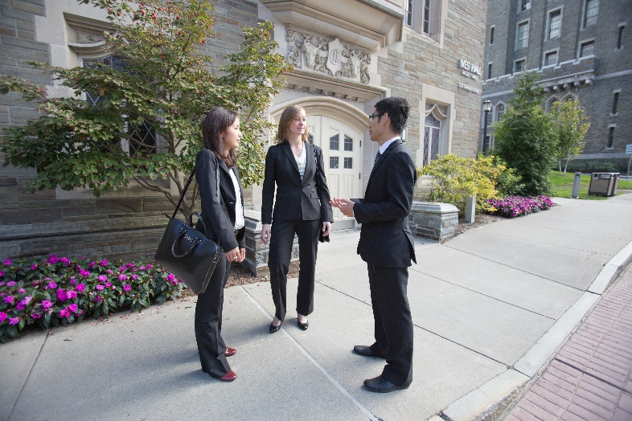
What is CAHRS?
The Cornell Center for Advanced Human Resource Studies (CAHRS) is the world's leading partnership between industry and academia, devoted to global human resource management.
Advance the practice of HR in your organization through:
Connecting with world class companies and faculty
Educating your HR team
Achieving your business goals
Founded in 1987

Slide 3
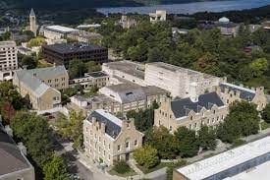
Why Partner with CAHRS?
Cornell ILR School is globally recognized as the best academic institution in the HR space
CAHRS unique combination of research studies, faculty access, recruiting events, HR body of knowledge and opportunities to connect with other similarly sized HR organizations is unmatched
CAHRS members have differential access to world class students and faculty
CAHRS members have discounted access to ILR Executive Education to build HR skills and capabilities

Slide 4
CAHRS Member Benefits
Connect
Focused Networking: interaction with other partners through Working Groups on specific topics of interest and a Partner Meeting that focus more in-depth on critical topics
Benchmarking: opportunities to benchmark with other partners on custom topics
Student Access: interaction with ivy-league Cornell students through Executive Roundtables, guest lectures and student networking
Educate
Research: ready access to Cornell studies, ResearchBriefs, CAHRScasts, videos, playbooks, and participation in customized research
Learning Series: small live/virtual sessions led by faculty on HR trends and skill building
Big Red Books (new): Academic-practitioner research collaborations producing playbooks
Library Access: access to searches by world renowned Catherwood Library and its staff
eNews: periodic newsletters (CAHRS Top 10, hrSpectrum, CAHRS Quarterly)
Achieve
Support your business mission through research and best practices in CAHRS nine COEs

Slide 5
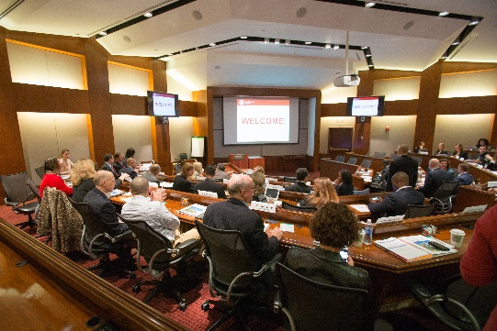
Connecting: Learning & Networking Opportunities
Partner Meetings – annual session with a strategic theme, showcasing member company stories (in Vegas-style confidentiality), research on topic by Cornell professors and moderated discussion.
Recent Themes: Leading HR in a Changing World; Post-Pandemic Talent Challenges; Future of Remote Work; Mental Health & Well-being; HR Transformation; Emerging HR Practices & Capabilities; HR Innovations
Working Groups – approximately 15 sessions per year offered inside and outside the United States. Limited to 25 attendees at a time to ensure robust discussion.
Recent Topics: Systemic Shifts in DEI&B; Talent Planning; Pay Transparency; Role of HRBP; Optimizing Hybrid Work; Engaging & Retaining Key Talent; Intersections of ESG & HR; Building HR Capabilities

Slide 6
Connecting with Partners through Benchmarking
Member companies can request the assistance of five to seven other CAHRS companies in an area of interest to them several times a year
Examples of requests: Digital Learning Strategy, Pre-Employment Screening, Disability Accommodations, HR Early Talent Rotation Programs, University Recruiting, Onboarding, The Offer Process, etc.

Slide 7
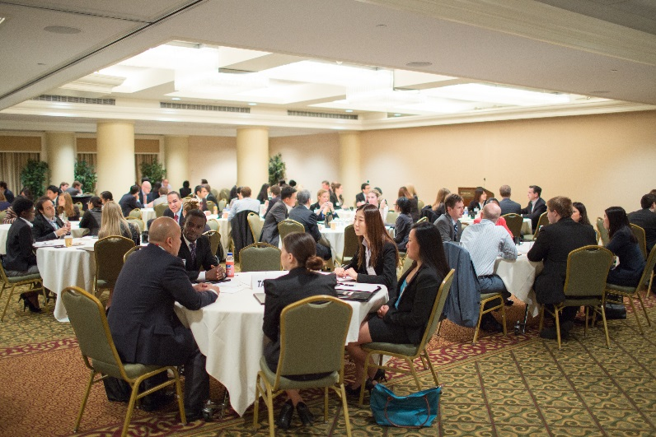
Connecting with Students
Differential opportunities to connect with both undergrad and graduate level students outside of recruiting
Executive Roundtables – unique yearly opportunity to rotate through seven individual tables of five to six students each to answer their questions on the top challenges in HR today
Networking – opportunities to meet informally with students at receptions held before or after partner meetings or other events
Guest Lectures – come to an ILR class to present on a topic of interest to both you and the students and showcase what’s happening at your company

Slide 8
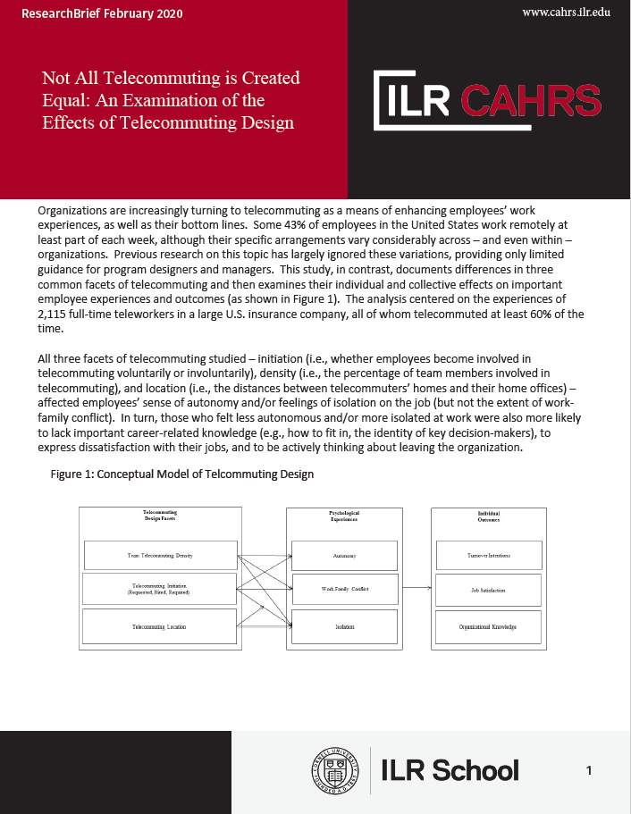
Educating through Research Opportunities
Access to Cornell studies, ResearchBriefs*, CAHRScasts, videos and participation in customized research (examples below)
Faculty Research: How Promotions Impact Internal Talent Market applicants; Do Layoffs Encourage Quitting; How do Training & Development Programs Influence Org Outcomes; Leading Virtually
Student Research – Executive Summaries on HR questions companies send to a class
Customized Research: Talent Strategies in an Ever-Changing World; Employee Value Proposition; Evolution of Total Rewards; Evolution of DE&I
CAHRScasts: Managing Talent in an Ever-Changing World; Optimizing Hybrid Work; HR Issues for 2023; Total Rewards Landscape
Videos: Emerging Technologies and the Future of Work, Income Inequality and the Future of Work, The Future of Work: What does it mean for the HR Practitioner?
*ResearchBriefs are executive summaries of Cornell’s world-famous faculty’s research work

Slide 9
Educating Your Team – CAHRS Learning Series
A faculty-led learning series focused on HR skill building and enhancing learning communities across CAHRS partner organizations.
WHO | WHAT | HOW & WHEN
Designed for HR generalists and HRBPs Member companies nominate one participant (more if space allows) Cohort capped at 35-40 participants | Faculty led sessions focused on trends, skill building, tools/strategies Sharing of effective HR practices across member organizations HR topics of interest (e.g., managing talent, succession planning, transformation, employee activism/ managing conflict etc.) | Series of 4-5 live-virtual sessions held over 1-2 months Participants expected to report back to sponsor on learnings Receive a CAHRS Learning Certificate and LI Badge
2024: Elevating Your HR Influence Using Data; Unlocking the Full Potential of Your Organization’s Talent Mobility Strategy
2025: Topics include Succession Planning and Organization Design

Slide 10
Educating Your Team -- Library Access
Access to Cornell’s Catherwood Library resources – the most comprehensive resource on labor and employment in North America
Assistance with two free custom searches by Cornell’s Catherwood librarians annually; additional searches available at a nominal charge
8

Slide 11
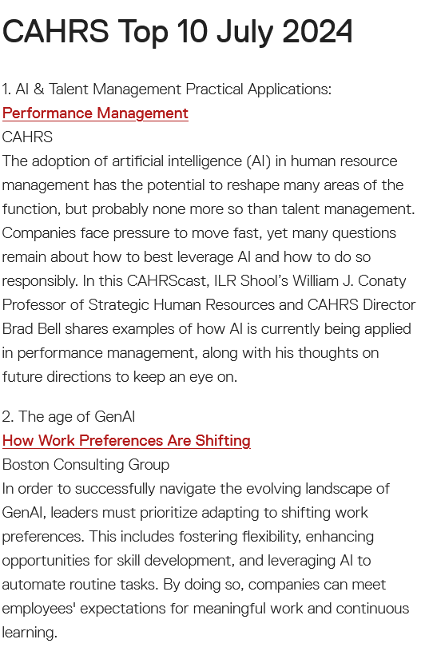
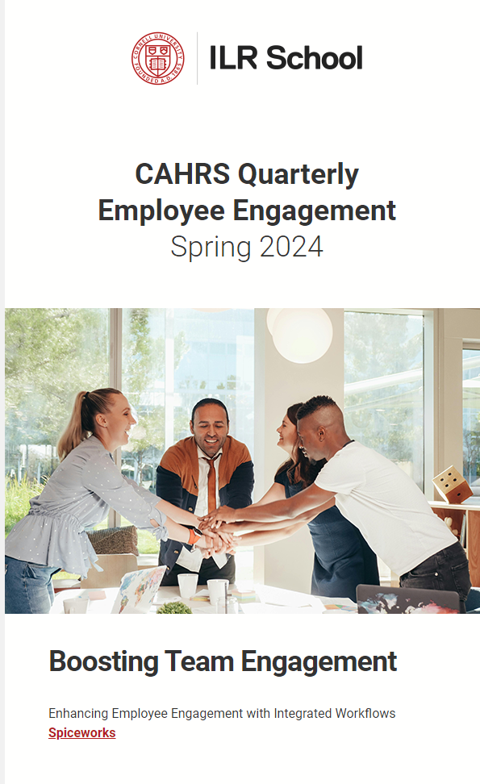
Educating Your Team -- Electronic News
Periodic compilations of the key developments in human capital space
Summarized with links to full articles
Easy to route to stakeholders in your organization
Opt-in to receive information that is most relevant to you from CAHRS’ Centers of Excellence (COEs)

Slide 12
Achieve
Support your business mission through research and best practice sharing through our Centers of Excellence approach:
CHRO/Future of the Function
Diversity & Inclusion
Employee Engagement
Globalization
HR Analytics/Metrics
HR Business Partner
HR Strategy
Talent Management
Total Rewards

Slide 13
CAHRS Membership Model
One yearly fee paid by member companies -- $22,500
Covers participation in all CAHRS events for any of your employees – as space allows (events first-come, first-served basis)
Travel expenses covered by member company

Slide 14
CAHRS Partner Companies
Accenture
American Express
Bloomberg
Boeing
Bristol Myers Squibb
The Cigna Group
CNH Industrial Colgate-Palmolive
Cornell University
Corning
Daiichi Sankyo
Docusign
Estee Lauder
Ford
GE Aerospace
GE Healthcare
GE Vernova
Hershey
IBM
Intel
Johnson Controls
JPMorgan Chase
KLA
Lumentum
Manulife
MassMutual
McDonald‘s
Medtronic
Merck
Otis Worldwide
Polaris Industries
Procter & Gamble
Prudential Financial
S.C. Johnson
Stanley Black & Decker
Shell
TE Connectivity
Terex
TIAA
Trane Technologies
UnitedHealth Group
Verizon
Workday
XPO
3/6/2025

Slide 15
CORNELL UNIVERSITY EXECUTIVE EDUCATION ACCESS TO BREADTH AND DEPTH OF OFFERINGS
ILR Senior Leader Programs*
External Education eLearning and Custom Programs
Modern CHRO
Modern Chief Diversity Officer
HR Strategy - Upskilling HR Capabilities to Drive Business Results
HR Leadership – Enhance Your Influence and Impact
Advanced Executive Selection Strategies
Executive Masters of HR Management
100+ Professional Certificate Programs*
500+ Expert-Led Courses
800+ On-Demand Learning Lessons
100+ Cornell University Faculty
Karen Siewert
kts47@cornell.edu
ecornellinfo@cornell.edu
*Discounted for CAHRS Partners

Slide 16
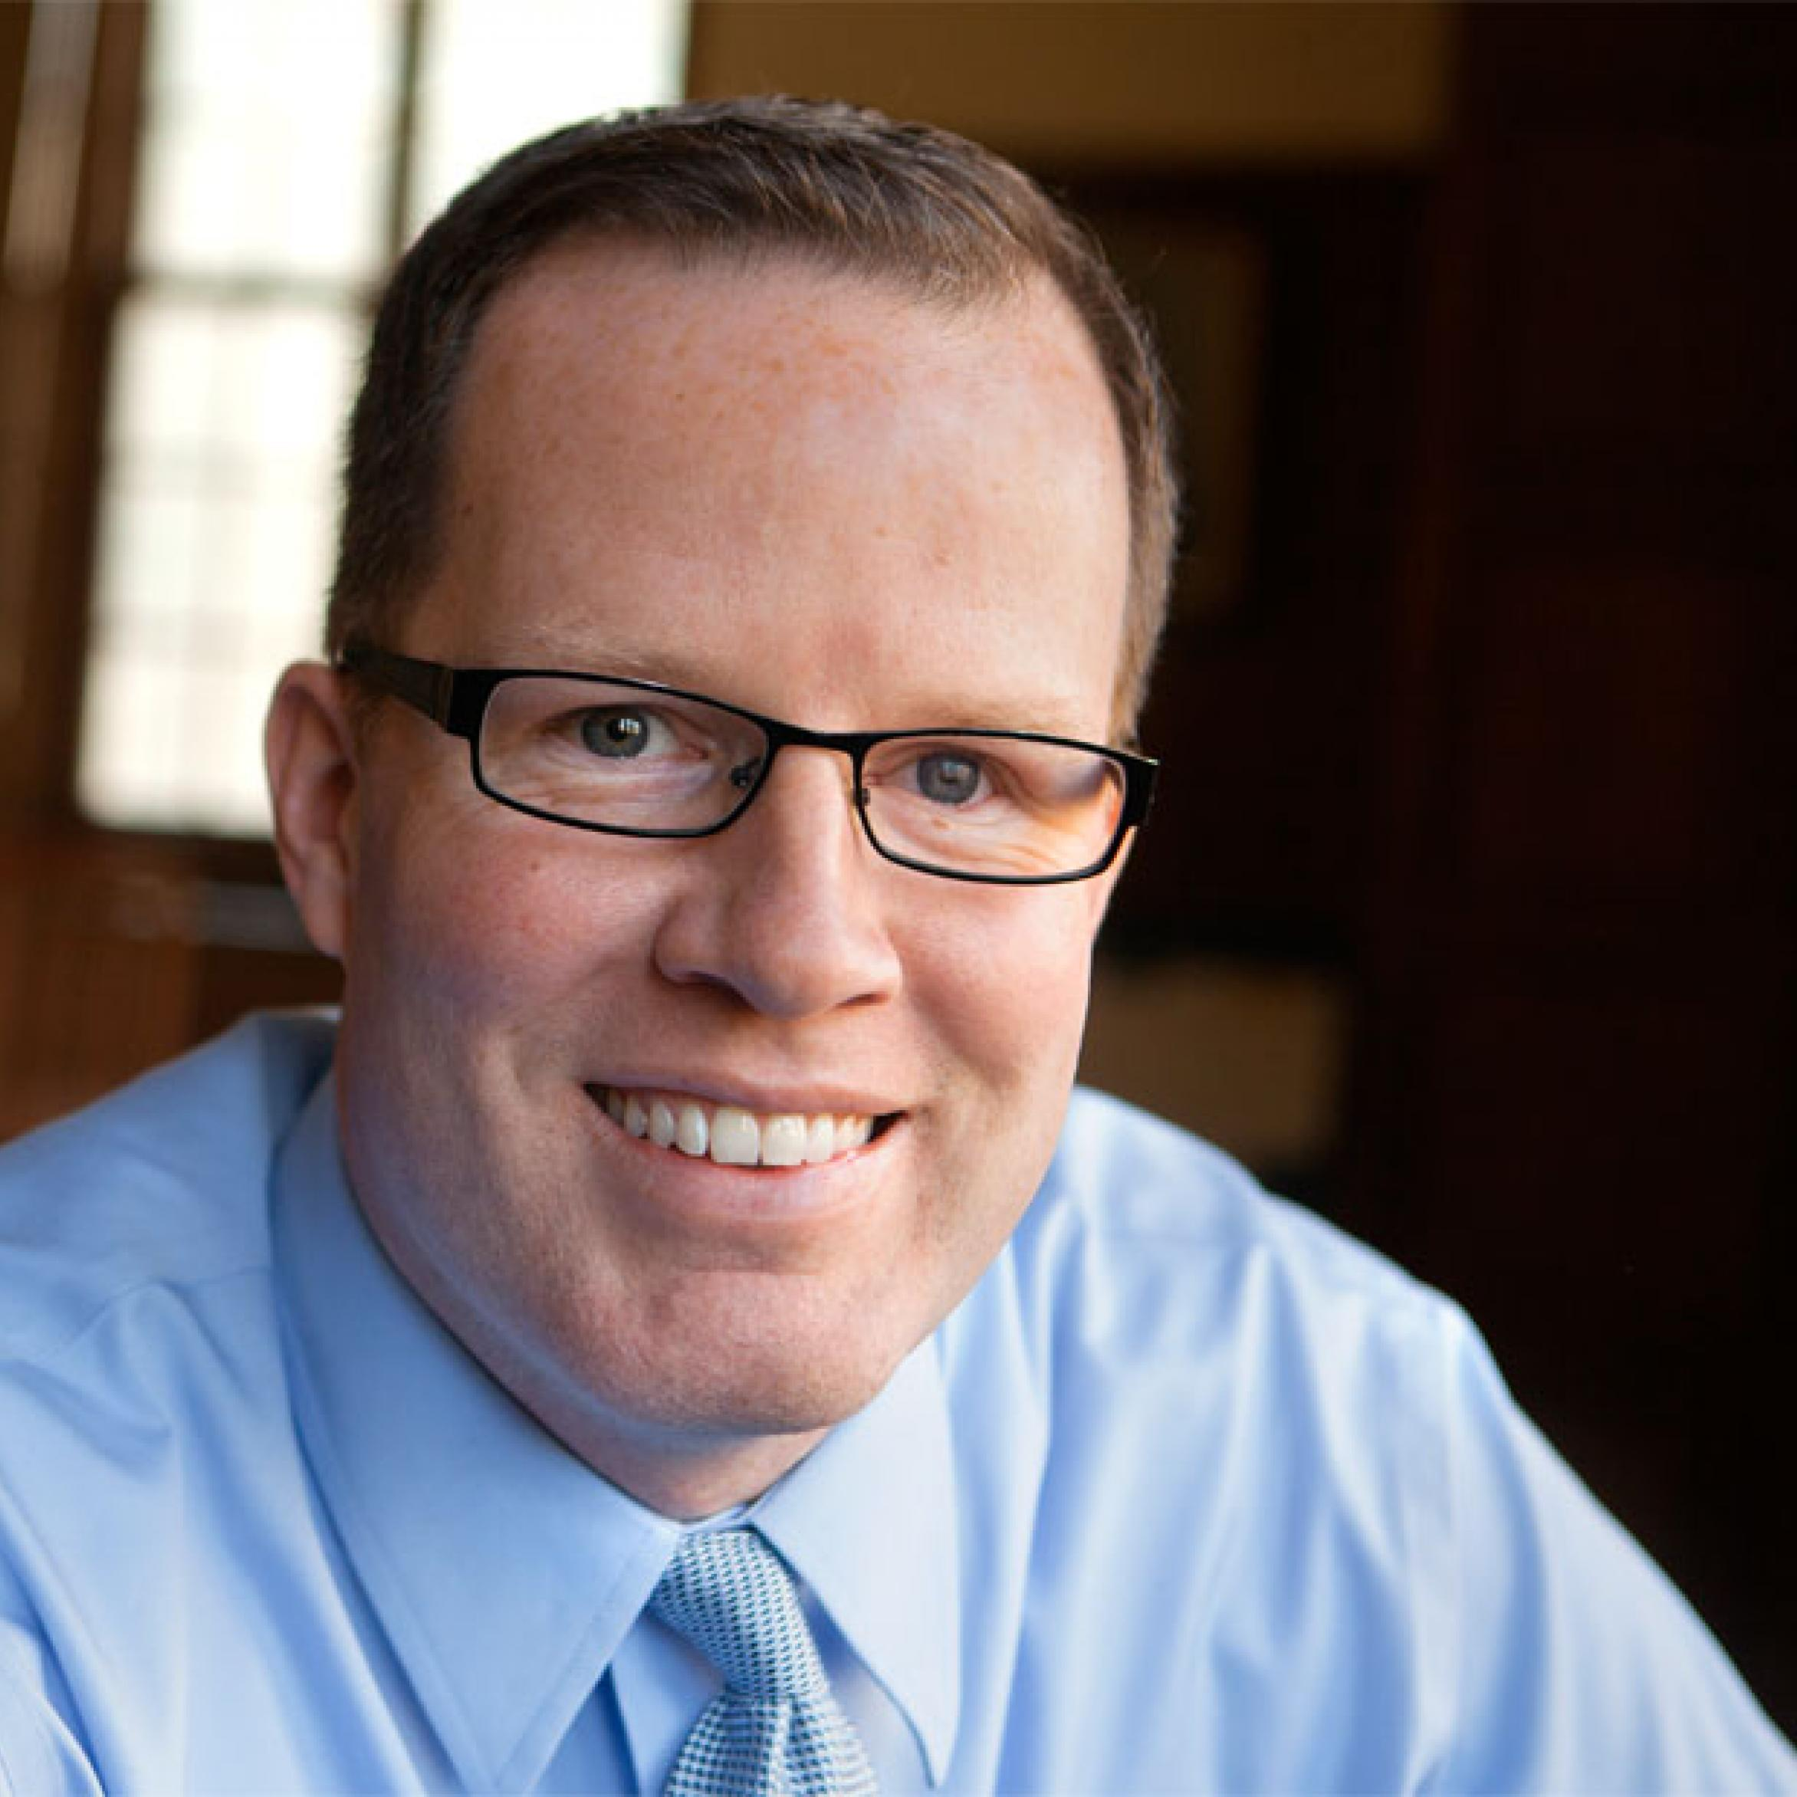
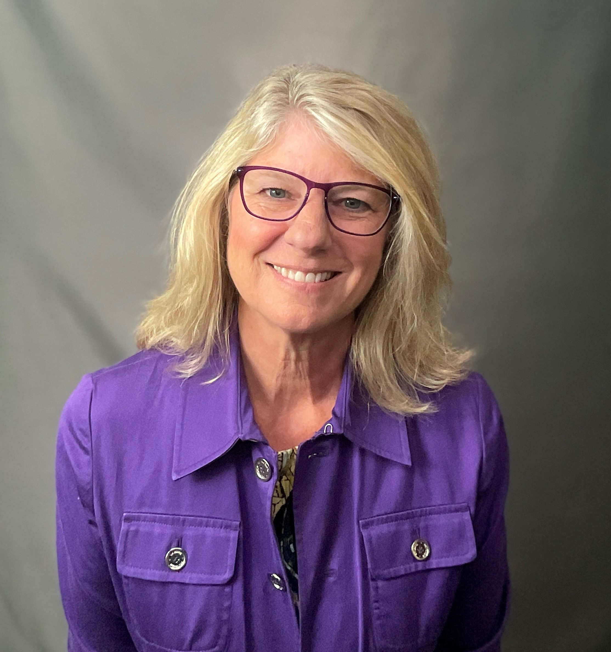
CAHRS Contacts
Brad Bell, Professor, Human Resources Studies
Academic Director of CAHRS
Brad.bell@cornell.edu, (607) 254-8054
Beth Flynn-Ferry, Executive Director, CAHRS
eef9@cornell.edu, 763-234-6022
http://www.ilr.cornell.edu/cahrs

